Slide 1
Bro-Online
By Ajaya Rai

Slide 2
End Of The Year Product
Web-app -> Bro-App
Technologies use: ReactJS + Firebase
Notes:
Show what you are planning build for the whole year

Slide 3
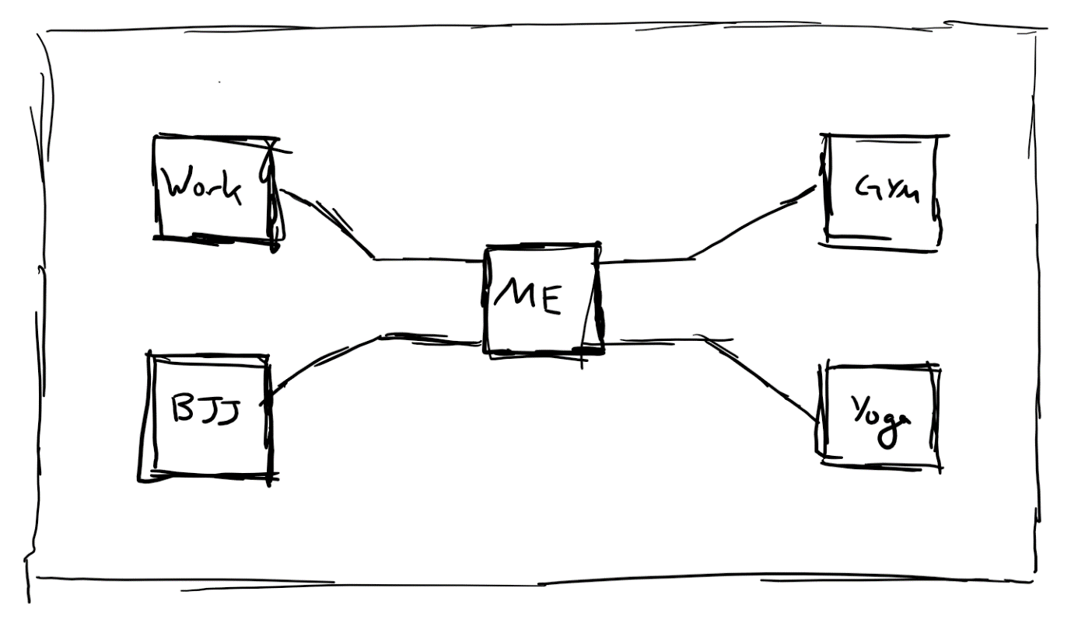
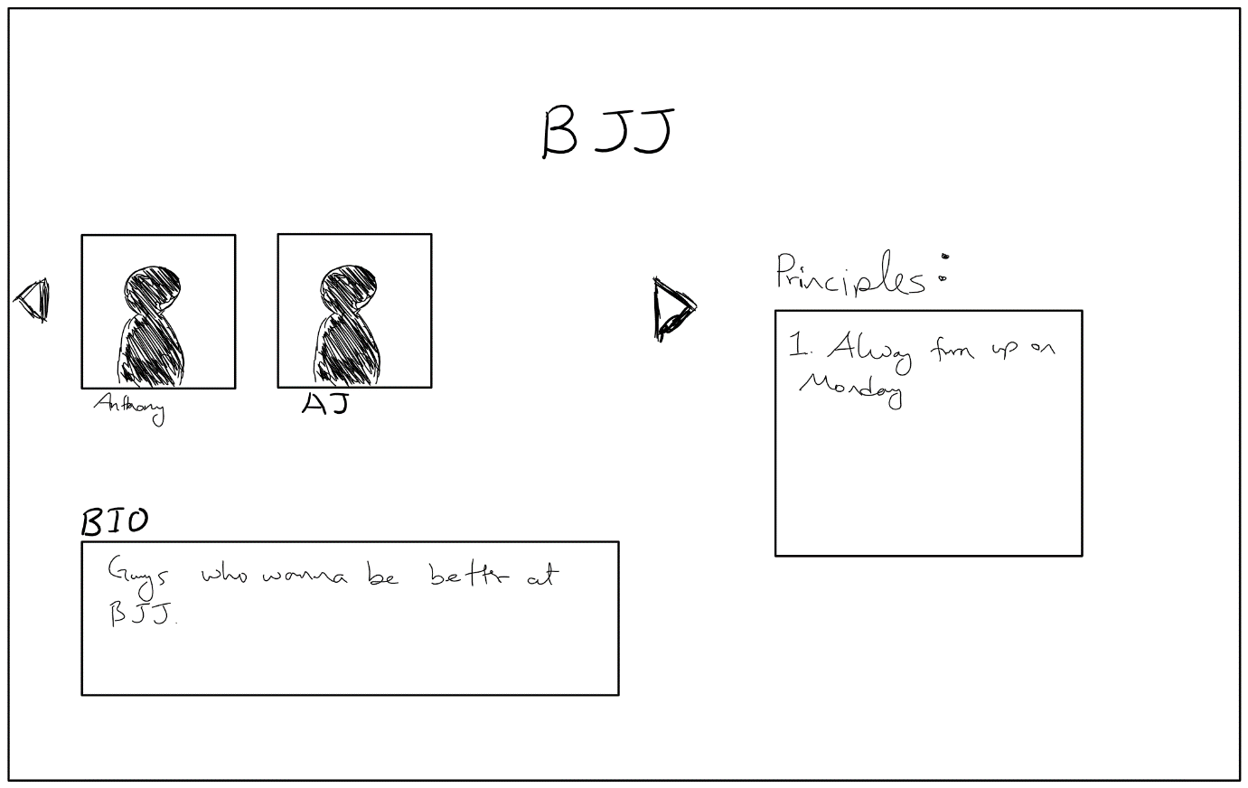
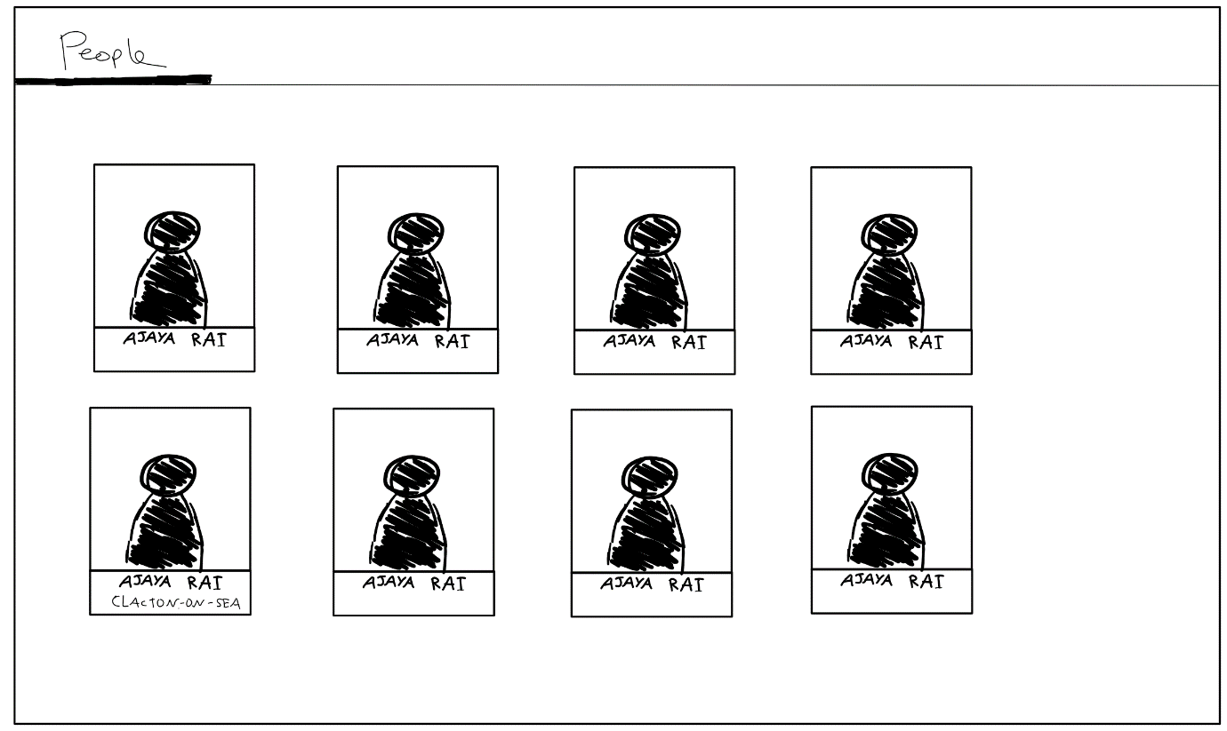
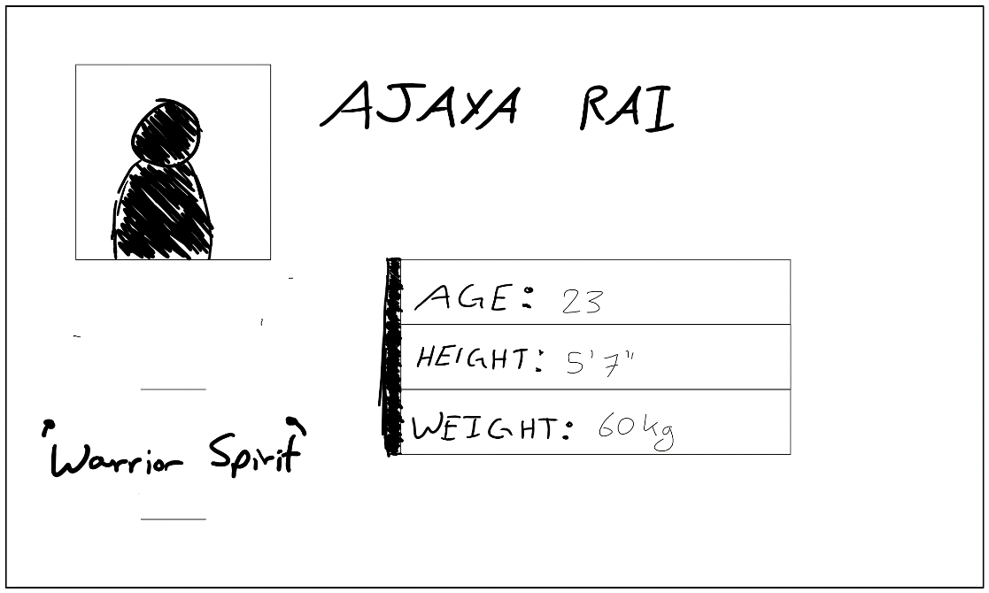

Home Page
Tribe Page
Search Page
Profile Page
Header

Slide 4

Why Bro-App?
Aim is to bring the brotherhood to our modern civil life. Why?
Accelerate self-improvement via ‘proving each other that they deserve to be part of the team’ [6] (Background Research Section: Disadv of brotherhood)
For well-being as claimed by [8] (Background Research Section: Adv of brotherhood)
[999]
Notes:
Cuz I want to bring brotherhood in the modern world
What is brotherhood?
Adv/Disadv
If brohood is soo good why is it lost In our society?
How have others gone about solving this problem?
Why building an app is one of the best ways to solve this issue?

Slide 5
If brotherhood is so great why is it lost now?
How have others gone about solving the lack of brotherhood in our society?
Why building the app is one of the best way to solve it?
Finding the group/creating it is the hardest part
Takes long to find like-minded people
‘Conscious deliberate effort’
Acts as an advert/promotion

Slide 6
MVP target
Focus on getting the logic done

Slide 7
Technical Achievement
Demonstration

Slide 8
Questions?

Slide 9
Reference:
[999] https://www.callofduty.com/content/dam/atvi/callofduty/wwii/home/sh-overview.jpg

